Slide 1
Walk2Work Wellness Desk:
Research Data Collecting
Group 2
By: Jonathan Silero, Jackson Parrott, Jacqueline Perdomo, Samantha Robinette and Cade Rogers

Slide 2
Our Goal:
Our goal was to gather data on three different areas in relation to treadmills: who is the target audience for treadmills, what features and prices are people interested in, and what do health publications say about walking.
We examined customer reviews and product listings and found that different groups such as remote workers, seniors, and fitness enthusiasts want specific features like foldability, quiet operation, and smart connectivity. With prices varying from budget to premium.

Slide 3
How was this going to be achieved?
.To gather data on demographics, we would use data analyzers such as web scraping tools on platforms like Amazon and Reddit to collect information on which treadmills people are purchasing, what features they prefer, and how they discuss their buying decisions, allowing us to identify trends and consumer preferences based on real world activity and options.
.Health information was seeked out through extracting abstracts and using AI to give a summary of the information talked about in all combined abstracts.

Slide 4
What is Data Scraping?
Programmatically gathering data from websites is known as data scraping
It’s used to gather data such as reviews, product specifications, and prices
Language tools such as Java (Jsoup), Python (BeautifulSoup), and Javascript
It functions very similar to a browser by parsing HTML or interacting with web pages.

Slide 5
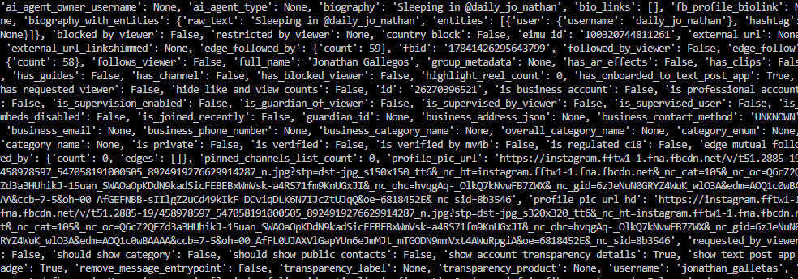
Gathering Demographics Original Plan
The original plan to collect demographics data was to collect data about the age and gender of people on Instagram that interact with the hashtag #desktredmill or similar hashtag. Unfortunately, not all instagram users have their gender and age publicly available. As more runs to gather data was done, the less actually viable data was available. This the moment where I decided to pivot to reddit.
This is an example of what would be unrefined data collected from an Instagram post.

Slide 6
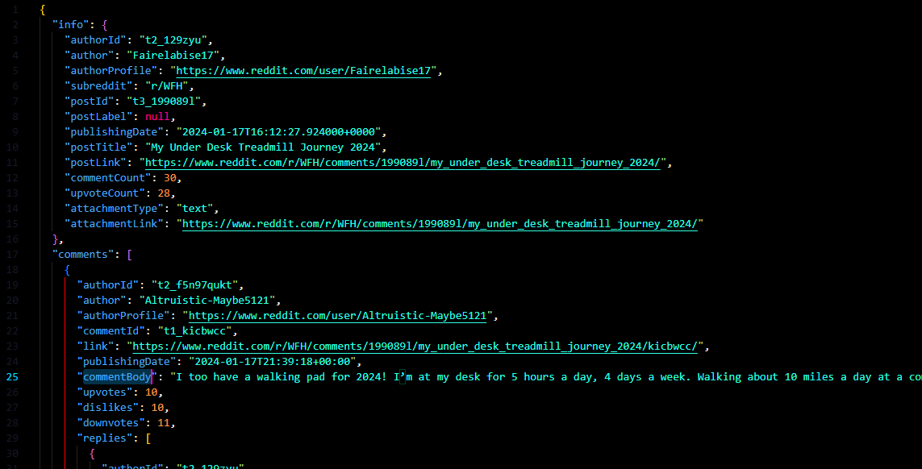
Gathering Demographics:
I created a scraper that would scrape comments from post that had the keywords “Desk” and “Treadmills”. This would be then stored into a json file that would then be changed into the desired information. For example, comment count per post and upvote per comment for the purpose of understanding which subreddit is most interacted with when talking about “Desks” and “Treadmills”.
Although I did not use (BeautifulSoup), I did use Python. I use the libraries httpx, a parser, and loguro so I did not have to actually filter through html.

Slide 7
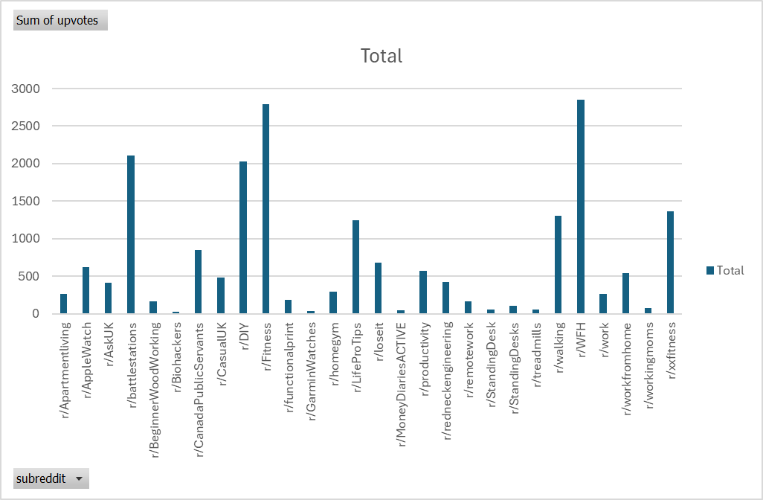
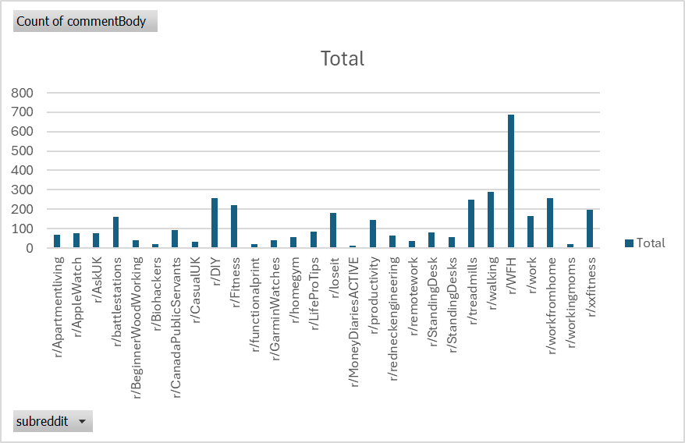
Demographic Results:

Slide 8
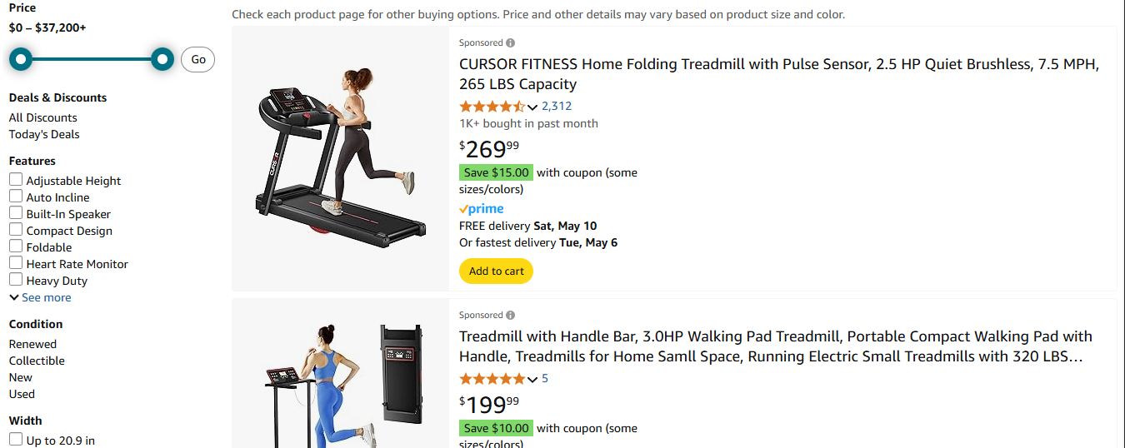

Gathering Consumer Feature and Price Preference:
To get a sense of what certain features consumers are looking for and what prices they favor more, we looked at web scraping Amazon listings.

Slide 9
Amazon’s Policy on Web Scraping
Amazon discourages scraping
Amazon frequently changes its site structure to prevent scraping
Possible consequences include IP blocking, CAPTCHAs, Legal notice or account termination

Slide 10
Gathering Consumer Feature and Price Preference:
How was this done?
Amazon treadmill listings were web scraped using Beautiful Soup 4, where a product’s name, rating, rating count and price were extracted and stored to a csv file.
Listings of both regular treadmills and walking pad treadmills were scrapped and stored separately. The listings then would be combined together into a single csv.
Why was Amazon chosen?
Amazon is the most popular online store where people buy products from and information about a product is easily available. Such information include, product names, features, price, number of ratings and product ratings.

Slide 11
Gathering Consumer Feature and Price Preference:
How was this data cleaned?
Despite how many treadmills listings were scraped, since regular treadmills and walking pad treadmills were scraped separately, duplicate product listings were present. There were also unwanted listings present for related products like walking belts and treadmill lubricants that needed to be removed as well.
Listings were cleaned by running the combined csv through “duplicate_entry_finder.py,” that removed exact duplicates based on name, ratings, rating count and price. The program also removed unrelated products by looking for keywords in product names.
The cleaned listings with all the removed duplicates and unrelated products would be stored in a new csv.

Slide 12
Gathering Consumer Feature and Price Preference:
How was the data used?
The main goal of gathering treadmill listings was to see what features and prices are consumers drawn into for treadmills.
The gathered data was analyzed in four different ways:
Feature popularity among the listings (what percentage of products included certain features)
Feature popularity vs. Actual Buyer engagement (what was the engagement of each feature in comparison to the products that included them)
Treadmill price distribution (the range of prices of the listings and how many fell under a price category)
Total review count per price range (what treadmill prices did consumers engage with)

Slide 13
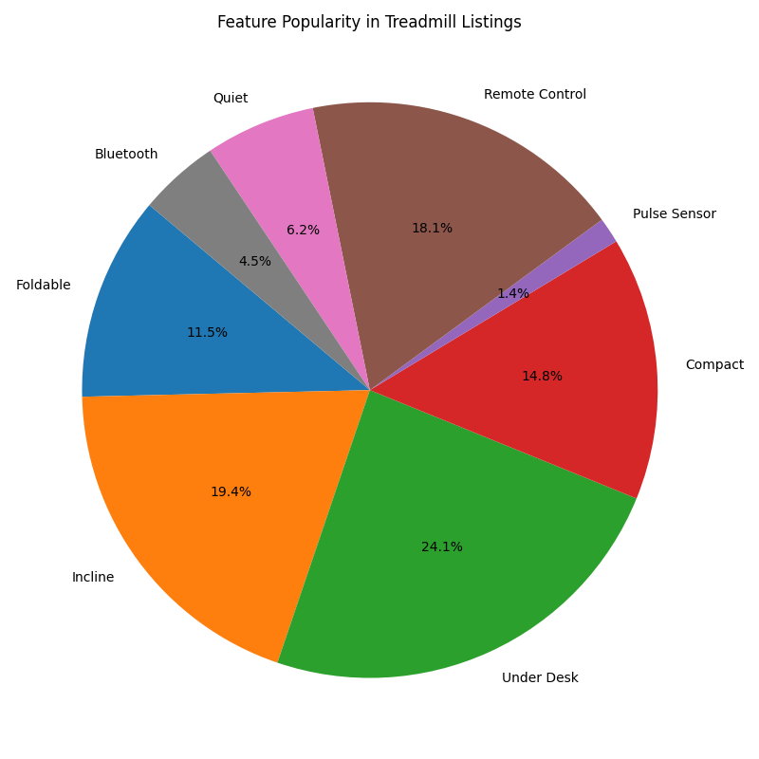
Gathering Consumer Feature and Price Preference:
Feature popularity among listings:
Each feature was looked for how many listings mention given feature
From all features, the most listed features were “under desk,” “incline” and “remote control”
Reflects what sellers advertise, not necessarily what buyers prefer

Slide 14
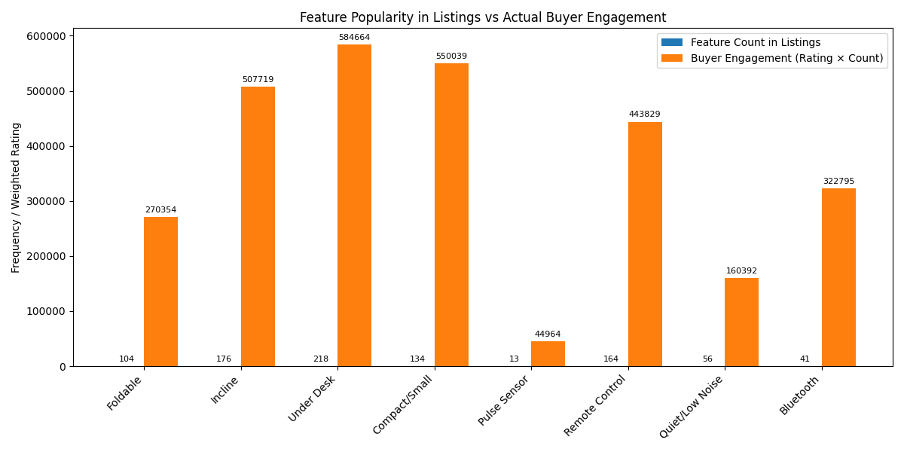
Gathering Consumer Feature and Price Preference:
Feature popularity vs. buyer engagement:
Two bars are shown, one that represents the number of listings and the other that represents a feature score
The weighted score reflects combined buyer approval and popularity
Certain features may be often advertised but may not affect how well treadmills with these features perform

Slide 15
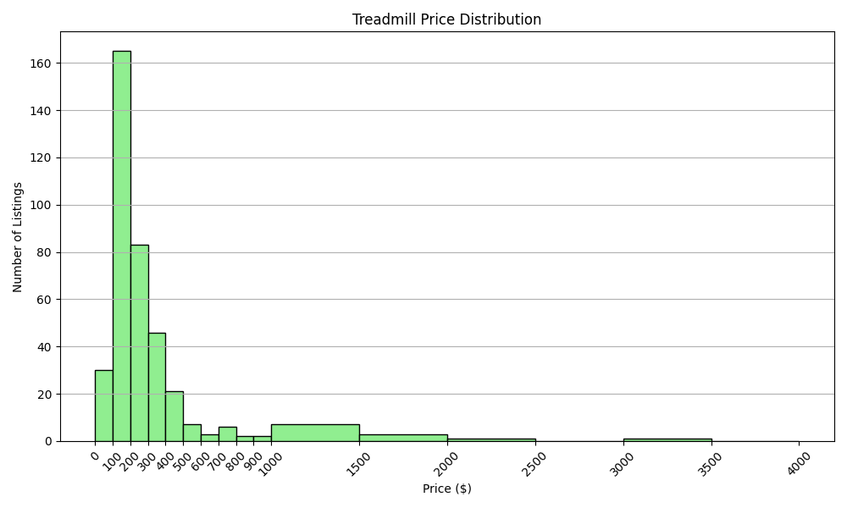
Gathering Consumer Feature and Price Preference:
Treadmill price distribution:
Shows how many treadmill listings fall into each price range
Majority of products target a price range below $1000, targeting affordability

Slide 16
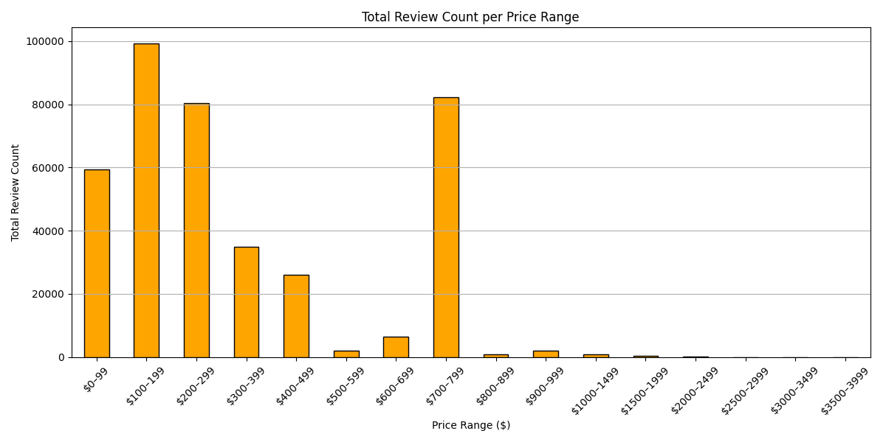
Gathering Consumer Feature and Price Preference:
Total Review Count Per Price Range:
Higher review count = more purchases made
Most engagement occurs at $100 - $799 price range
Higher prices ($800 and above) get fewer reviews, meaning niche buyers

Slide 17
Gathering Consumer Feature and Price Preference:
What does the data suggest?
Features like compactness, incline and under desk that are widely listed are well received
Some less advertise features like bluetooth do gain traction as well
Price is important for consumers as they prefer affordable to mid range models ($100-$799)

Slide 18


(APMA) AI-Powered Mass Analysis
What is AI-Powered Mass Analysis?
APMA is the use of LLMs to sort through large quantities of information to find information that would make the product more alluring to customers and predict demographics that would benefit from the Walk to Work Treadmill.

Slide 19
APMA: Choice of data collection
What data was chosen?
The data that was chosen was studies from the PubMed Database.
Why was this data chosen?
PubMed is very friendly to data collection, PubMed is a database that hosts studies from reputable medical journals, and has a massive collection of medical research.
How was the data collected?
Using PubMed’s API Entrez a python script was able to pull abstracts of studies based on Boolean search terms, and store them in a CSV file where the information was sorted by its PMID and the abstracts text.

Slide 20
AIPMA: Processing the Data
What Processed The Information?
Ollama running Llama 3 .
Why was the information processed?
To find information on who would be a good group to market to, what additions might need to be made to the product, and potential marketing strategies..
How was the information processed?
Llama 3 running on a local Ollama server ran batches of prompts.
These prompts contained
A Primary Directive, that directed the LLM to search for information that would help in making the product attractive to customers and find groups that would be receptive to the product, and potential marketing strategies.
A subset of abstracts and PMIDs from the list of abstracts saved to the CSV.

Slide 21
APMA: Final Interpretation
From the analyses by the AI the following information was gained:
Showcasing Health benefits from daily walking would enhance product appeal.
Stating the benefits low-impact exercise would enhance product.
Older individuals, individuals with back pain, individuals with Parkinsons, would be demographics that would benefit greatly from the Walk 2 Work Desk.
Adding customization based on age, sex, and BMI for walking session data collection and custom walking goals would increase the appeal of the product to a wider variety of consumers.
Focusing on walking burning primarily fat as calories would increase product appeal.

Slide 22
Qualitative concerns
Gathering from various studies and Reddit, there exist potential barriers to the adoption of treadmill desks in the office. They include;
Lack of familiarity of a folding desk concept
Noise concerns arising with familiarity primarily with gym equipment
Concerns of workplace disruptions through noise, visually distracting movement, and tremors
Lack of job autonomy or trip-hazard concerns may lead to preemptive bans depending on the office.

Slide 23
Scraping Google Scholar:
Futility
Web-scraping is a gray area in general, not explicitly illegal, but not necessarily endorsed either.
Google generally restricts activities disruptive or harmful to their services, including crawlers and scrapers.
Google defends itself through monitoring retrieval rates and bans on IP addresses that exhibit excessive behavior, or has a symptom of a bot.

Slide 24
Workarounds
One such way to continue to work with Scholar despite the risks is through the Scholarly Python library.
Combined with rate-limiting (which is just polite to do, as well as effective at avoiding attention), it also allows connecting to proxy generators, or even offering free ones.
Don’t do this at home, kids. Being blacklisted by Google won’t be fun for you.

Slide 25
How could this be expanded upon or improved?
Include other retailers such as Walmart, eBay, Best Buy, Peloton.
Expand the type of data collected like technical specs, warranty details, or shipping options.
Add an automatic scraper that scrapes daily/weekly to detect price changes.
Implement deduplication logic to avoid listing the same treadmill multiple times.
Integrate with machine learning to predict price trends over time and identify fake reviews.
Improve scraper resilience by using headless browsers to navigate JavaScript heavy sites. Also to rotate IP’s and use proxies to avoid blocks. Using CSS selectors to detect and respond to page structure.
Ensure legal and ethical compliance to use API’s where possible and include disclaimers or respect site terms. Also respect robots.txt and add delay between request to reduce server strain.

